Slide 1

Technical Skills and Digital Tools
WEEK 5

Slide 2
Lesson outcomes:
Identify key digital tools used in the industry, including collaboration software, cloud platforms, and coding tools.
Explore the impact of automation and AI on professional practices.
Understand theoretical frameworks that explain the acceptance and spread of technology.

Slide 3





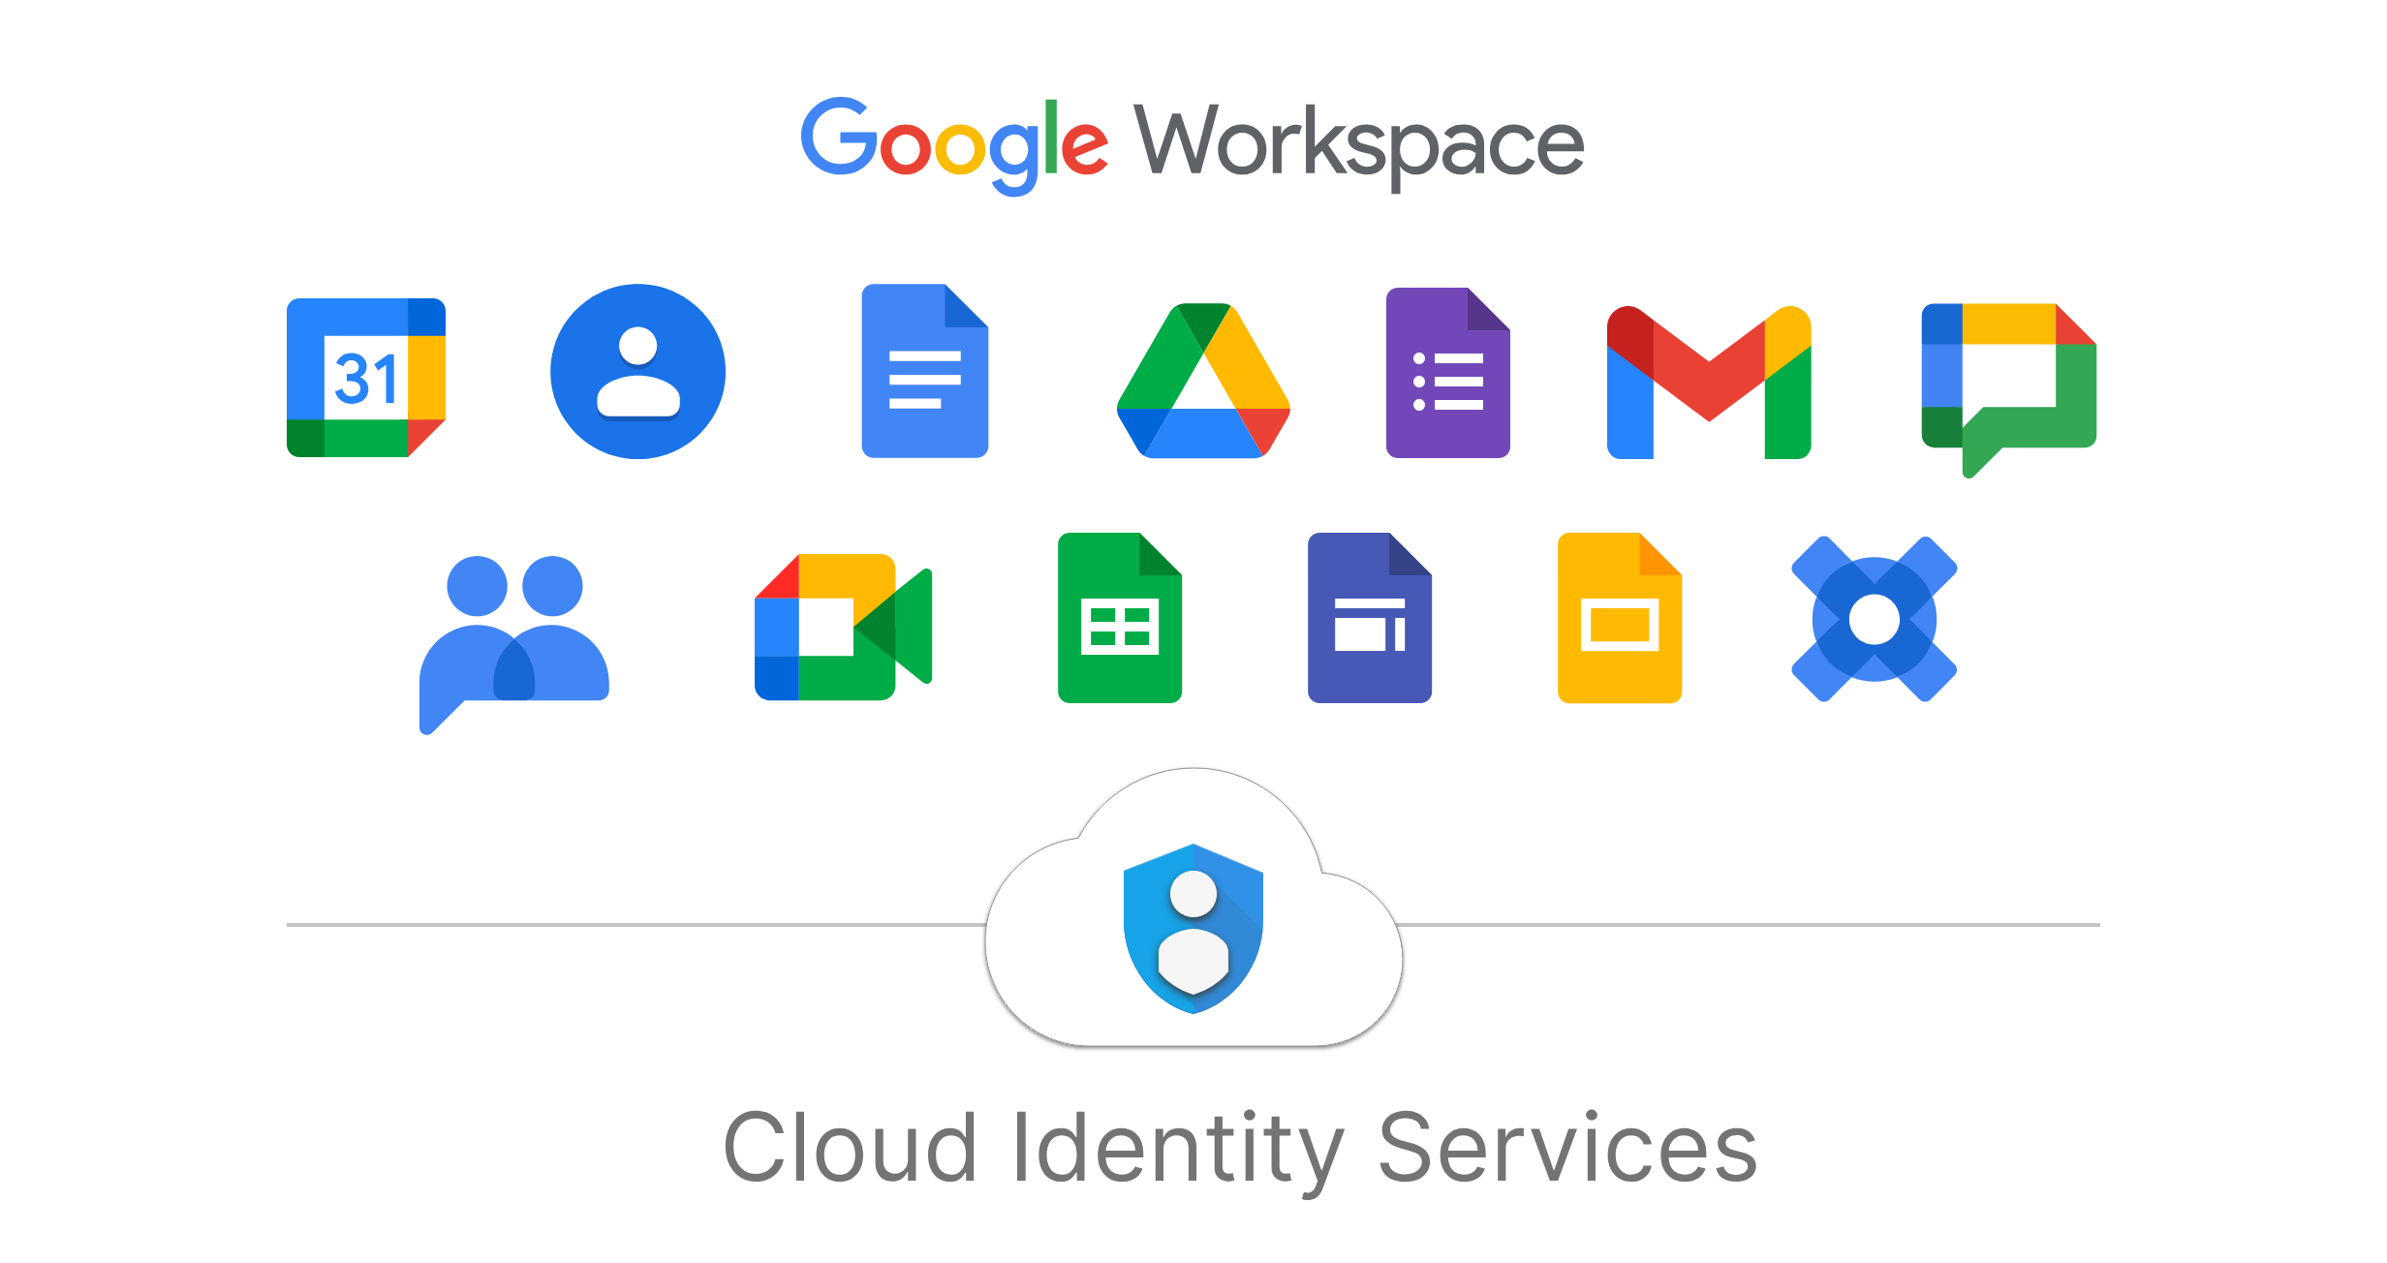


Introduction
Project Management Tools
Communication Tools
Essential digital tools help professional in diverse aspects of the work including plan, execute, communicate, track progress, etc.,
Cloud Storage and Collaboration Tools
ERP Systems

Slide 4
01
Concepts
Answer the question in the box below
Why are technical skills and familiarity with digital tools important in the modern workplace?

Slide 5
Integration of automation
…and AI in daily professional tasks:
Data driven
Streamlined Administrative Tasks
scheduling, data entry, and report generation
Enhanced Decision-Making
forecast trends, optimize resource allocation, and personalize customer experiences
Smart Project Management
forecast project timelines, predict potential delays, and allocate resources effectively
Personalized Customer Service
handle multiple queries simultaneously, improving customer satisfaction and reducing workload for human agents

Slide 6
Choose the correct ones:
Which of the following can repesent automation of tasks?
01
02
01
generating reports;
drafting emails;
writing content tailored to specific audiences
tracking progress in real-time and suggesting adjustments to keep projects on track
Crafting original marketing campaigns, developing unique product concepts, or strategizing a company's brand identity

Slide 7
02
Theory Overview
Diffusion of Innovations

Slide 8

History of the “Diffusion of Innovations Theory”
The diffusion of innovations (DOI) was popularized by Everett Rogers in his book Diffusion of Innovations, first published in 1962.

Slide 9
What Is the Diffusion of Innovations Theory?
The diffusion of innovations theory is a hypothesis outlining how new technological and other advancements spread throughout societies and cultures, from introduction to widespread adoption. The diffusion of innovations theory seeks to explain how and why new ideas and practices are adopted, including why the adoption of new ideas can be spread out over long periods.

Slide 10
What is the Diffusion Curve?
The diffusion curve encompasses five distinct adopter categories, showing how innovations are gradually embraced by different segments of the population.
These five groups of buyers and developers are categorized as follows:
Innovators: Tech enthusiasts and pioneers.
Early Adopters: Visionaries and forward-thinking entrepreneurs.
Early Majority: Pragmatic users who seek practical solutions.
Late Majority: Cautious individuals who are skeptical or conservative.
Laggards: Traditionalists who are the last to adopt new technologies.

Slide 11
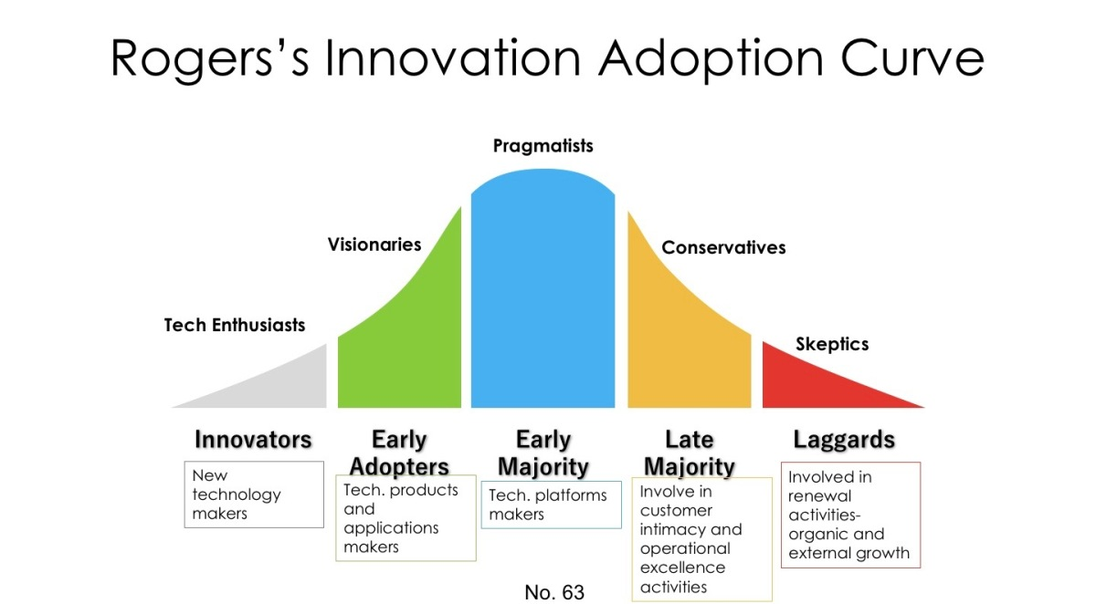
34%
12.5%
34%
2.5%
16%

Slide 12
Where can Diffusion of Innovations be used?
In marketing, this diffusion of innovations theory is often applied to help understand and promote the adoption of new products.
The diffusion of innovations theory can also be used in areas such as public health to encourage populations to adopt new, healthy behaviors.

Slide 13
Let’s discuss!

Slide 14
03 Digital Tools Overview
Collaboration Software, Cloud Platforms, and Coding Tools

Slide 15

Collaboration Software
a digital tool that allows people and teams to work together on projects and tasks by sharing information and data

Slide 16
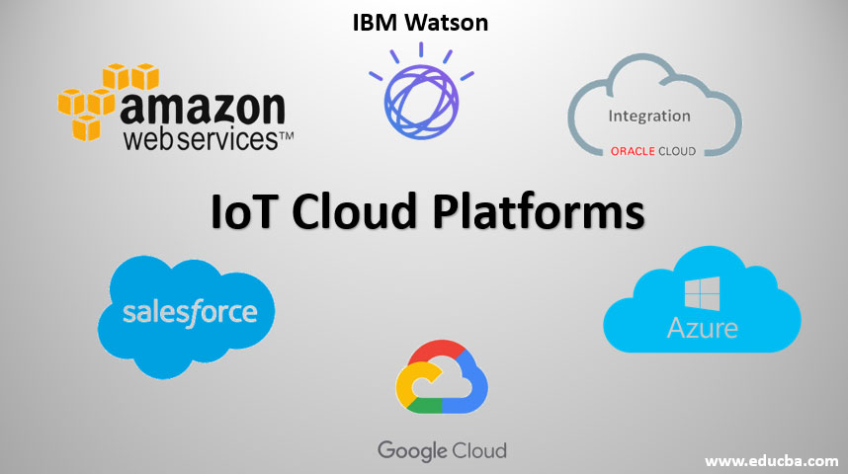
Cloud Platform
a system that provides cloud computing services to customers by using the hardware and operating systems of servers in a data center.

Slide 17



Coding Tools
also known as programming tools or software development tools, are computer programs that help developers create, debug, and maintain applications

Slide 18
Activity

Slide 19
Activity:
4 people in one group
Choose a company case study adopting new technology either automation or AI-based tools (e.g., chatbots in customer service, automation of administrative tasks, or cloud-based software development).
Task:
Each group will:
1. Analyze the case study using Diffusion of Innovations.
2. Identify the challenges and benefits of adopting automation or AI tools.
Discussion:
How did the company manage technology acceptance and adoption? What impact did the automation/AI tools have on their work processes?

Slide 20

THANK YOU!

